Slide 1

How to install Helloblock
Yahboom
Yahboom OMIBOX Tutorial

Slide 2

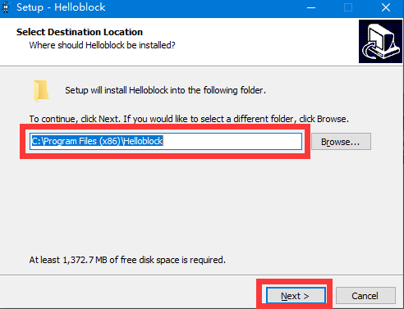
1.Double-click the Helloblock V1.0.6.exe that we provided to start the installation.
2.Select the installation path, we need to choose the default installation path, no additional modifications,
just click 【Next】.
Yahboom OMIBOX Tutorial

Slide 3
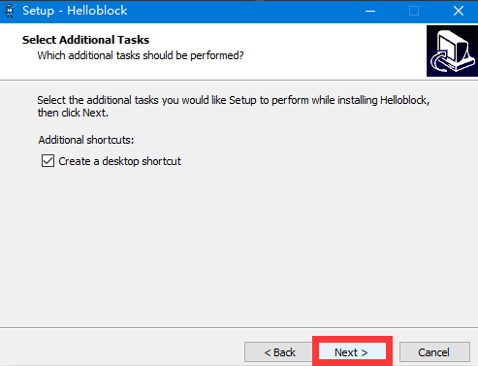
3. By default, create a shortcut on the desktop, we just need to click 【Next】.
Yahboom OMIBOX Tutorial

Slide 4
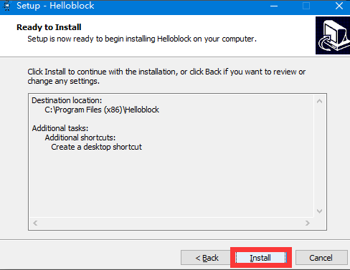
4.Click【Install】.
Yahboom OMIBOX Tutorial

Slide 5
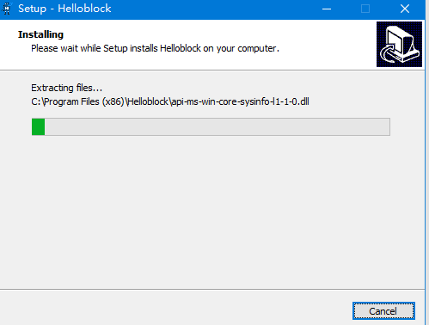
5. Wait patiently for the installation progress bar to scroll.
Yahboom OMIBOX Tutorial

Slide 6
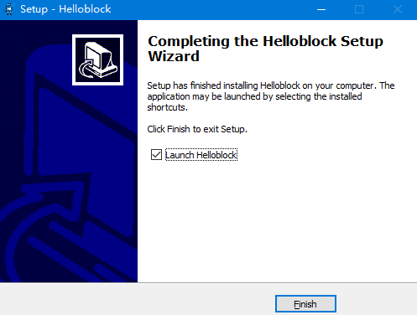
6.Click 【Finish】.
Yahboom OMIBOX Tutorial

Slide 7
Inspire Creativity Embrace Innovation
Thank you!!!
Yahboom

